Slide 1
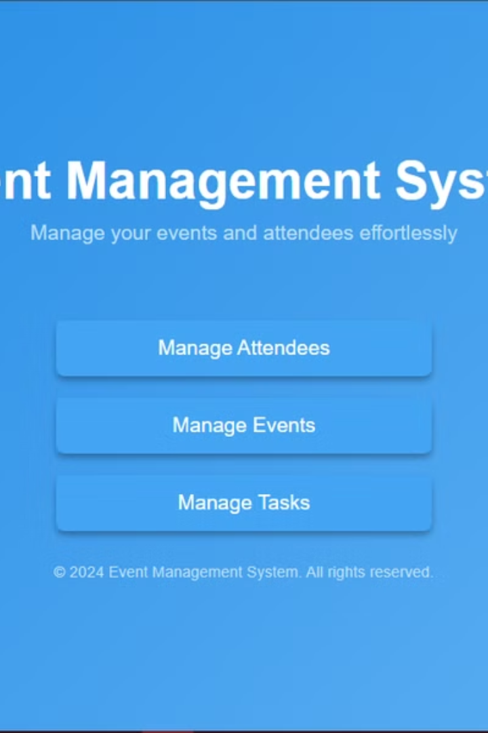
Event Management System
Introducing a powerful web application designed to simplify event planning and management, offering seamless control over all aspects of your event. The system is built to handle the intricate details, freeing you to focus on the big picture.

Slide 2

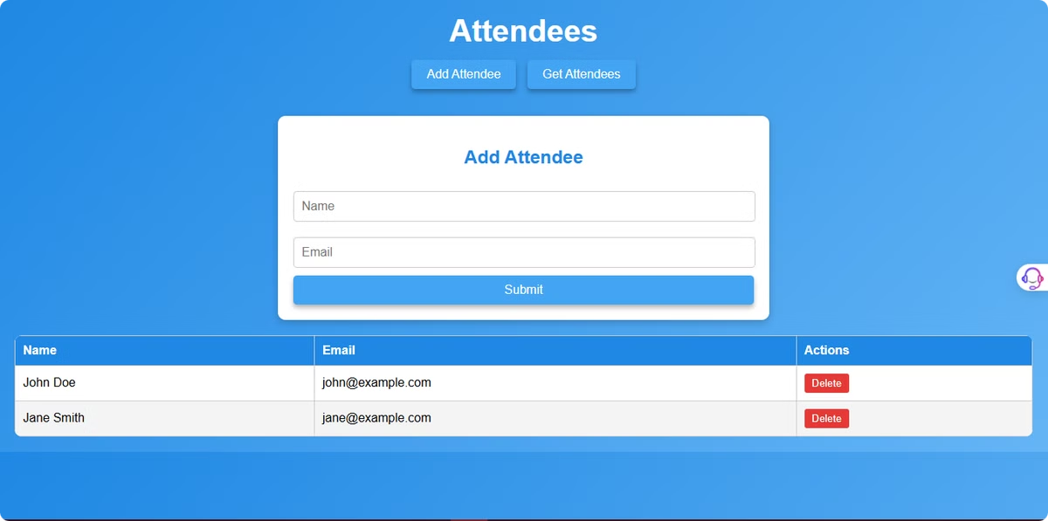
Simplified Attendee Management
Our Event Management System provides efficient tools to manage attendees with ease. From registration to tracking, every step is streamlined to save time and ensure accuracy.
Key features include attendee registration, profile management, and updates using simple CRUD operations. RESTful APIs enable smooth communication, ensuring data consistency across systems. A dedicated interface empowers organizers to efficiently handle attendee information and related tasks.

Slide 3

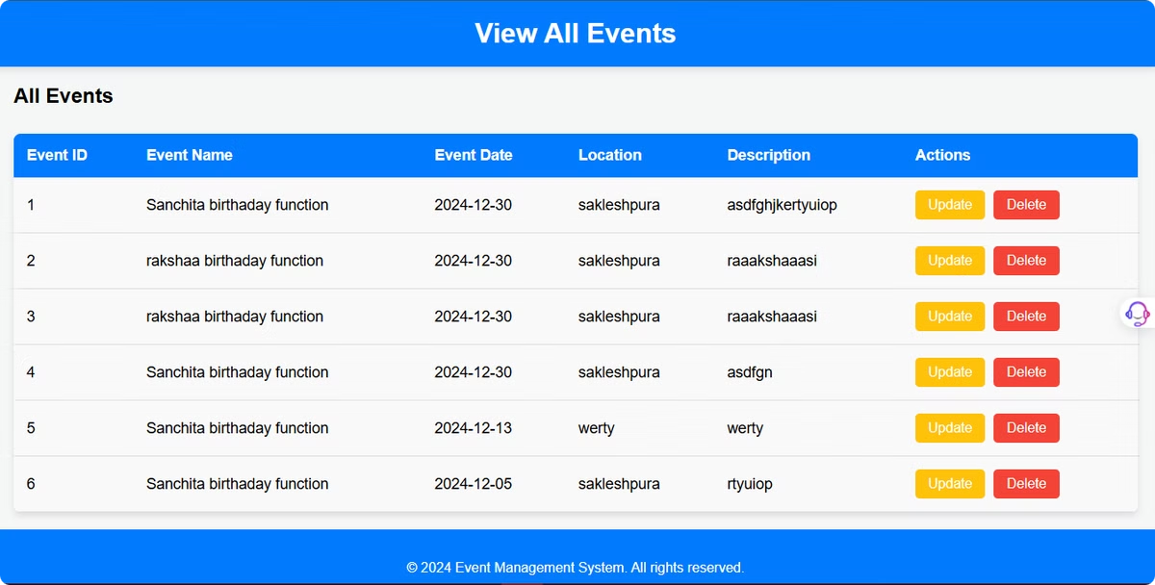
Simplifying Event Management
Our system provides powerful tools designed to streamline event creation and management. From seamless event setup to intuitive event viewing, we empower you to organize and oversee events effortlessly. Focus on delivering memorable experiences for your attendees.

Slide 4

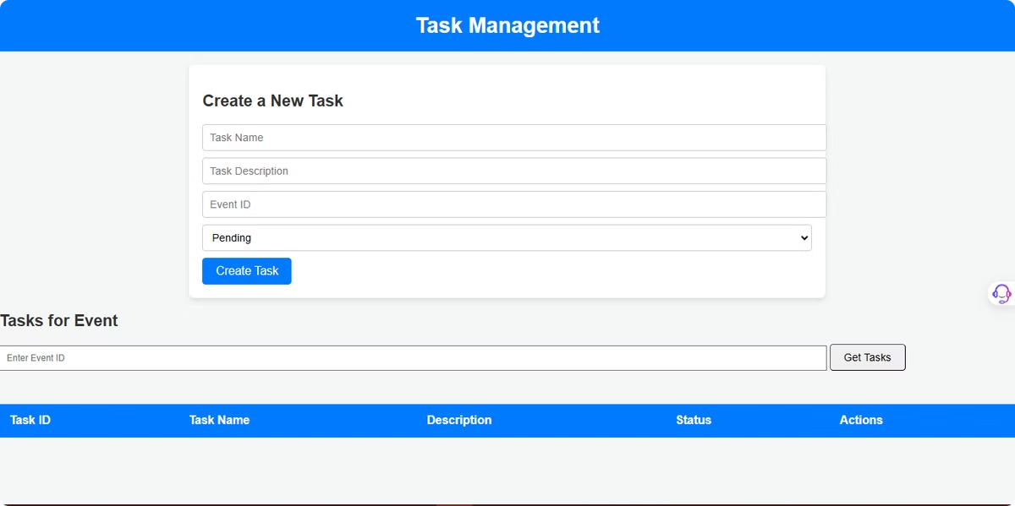
Simplifying Task Management
Our system offers efficient tools to streamline task handling for your events. From creating and assigning tasks to tracking their progress, we empower you to stay organized and ensure every event runs smoothly. Focus on achieving your event goals with ease.

Slide 5
Key Features: Empowering Event Success
1
Event Creation
2
Event Updates
3
Attendee Management
Create detailed event profiles with customizable settings, including date, time, venue, and speaker details.
Modify event details, manage attendee lists, and send updates and reminders to attendees.
Track attendee registration, manage check-in, generate reports, and analyze event data for future planning.

Slide 6




Technologies: A Robust Foundation
Java
Spring Boot
MySQL
Our backend is powered by Java, known for its robustness and scalability. It provides a strong foundation for handling complex business logic and data management.
Leveraging the Spring Boot framework, we streamline development and deployment, enabling rapid iteration and efficient resource utilization.
MySQL serves as our reliable database, ensuring secure storage and efficient retrieval of event and attendee data.
HTML/CSS/JS
The user interface is crafted using modern web technologies, including HTML, CSS, and JavaScript. This approach ensures a responsive, user-friendly experience across devices.

Slide 7



System Architecture: A Seamless Integration
Backend
Our backend is built using Java and Spring Boot, responsible for managing data and business logic.
API
RESTful APIs provide a communication bridge between the backend and the frontend, facilitating data exchange and integration.
Frontend
The frontend, powered by HTML, CSS, and JavaScript, delivers a dynamic and engaging user experience.

Slide 8
Prerequisites: Setting Up Your System
JDK 11+
MySQL
Maven
Ensure you have a compatible Java Development Kit (JDK) installed on your system. Version 11 or later is recommended.
Download and install the MySQL database server. It's essential for storing and managing event and attendee data.
Maven is a build automation tool that simplifies dependency management and project compilation.

Slide 9

Conclusion: Transforming Event Management
Our Event Management System is designed to revolutionize event planning and management. It empowers event organizers with a comprehensive solution for seamless event creation, attendee management, and data analysis. By simplifying the process and providing valuable insights, this system helps create unforgettable events that leave a lasting impact.

